Slide 1



“Parents can position their child for academic success long before the first day of kindergarten. A vibrant life of learning begins at birth.”
Nancy Kerr, President of the National Reading Council
Cedar Wood Elementary
Kindergarten Parent Orientation
Notes:
David

Slide 2
Your Hosts
Dr. David Jones, Principal
Mr. Daniel Natividad, Assistant Principal
Ms. Rhoda Onken, Office Assistant
Ms. Amy Yardley, Kindergarten Teacher
Ms. Tammy Whipple, Kindergarten Teacher
Notes:
David

Slide 3
Enduring Influences
Parents
Family, Friends, Community
Educators
Media
Notes:
David

Slide 4

Parent/Teacher/Association (PTA) provides essential volunteer and financial support to the school.
Join the PTA.
Connect with other families with similar goals and interests
Become better informed
Learn of ways to be involved and to support your child and his/her school
PTA website: http://www.cedarwoodpta.org/
Notes:
PTA Rep

Slide 5
  SeaPub Chairs
  Mandy Banks and Breanne Pumper
Notes:
David

Slide 6
Sea Pup Program
Summer Play Events
  July 12 1:00 – 2:30
  July 24 1:00 – 2:30
  Aug 8 11:00 – 12:30
August Picnic August 28th 4:30 – 6:00
Kinder Parent Coffee
  Monday, September 10th, as children begin their first day of school
Notes:
Mandy and Breanne

Slide 7

Our community YMCA provides a safe and supportive before and after school environment on our campus.
Child Care is available starting
at 6:30 a.m. and ending at 6:30 p.m.
Notes:
Shirley or Amy

Slide 8
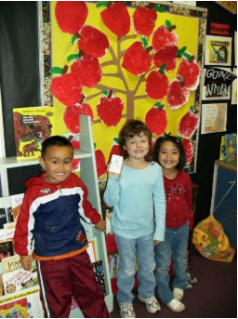
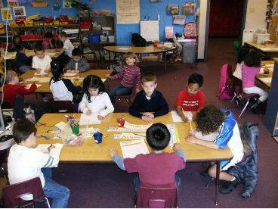
A Day in Kindergarten
Notes:
Daniel: Welcome to Kindergarten in Everett School District! We’re so glad you’ll be joining us next year. It will be a wonderful and exciting year with lots of new things that your child will do and learn.
We want to share a little bit about what it will be like in kindergarten – what students do each day and some of the things they will be learning.

Slide 9
First Day of School
Probably September 10th
WaKIDS Family Conferences probably September 5th, 6th and 7th
Parent coffee in cafeteria after the first day begins. Say goodbye and join other parents.
2
Notes:
Daniel

Slide 10
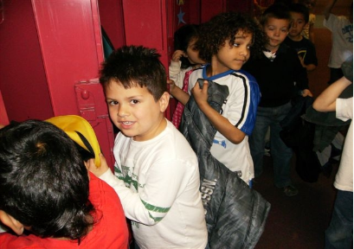
Beginning of the Day
  Breakfast program is available, starting at 8:45
  Non-breakfast students line up in the kinder area starting at 9:00
  Students are walked into the classroom at 9:05
  They leave their coat & backpack in their locker
Notes:
Amy/Tammy: Each day when you arrive you’ll have a special place to go and wait until the bell rings and your teacher is ready for you to come into the classroom. Some children may go to the before-school-care, usually in the cafeteria, if your parents have arranged for this. Others may eat the school breakfast. Everyone else will have a spot outside where they’ll wait.
When you come into your classroom you’ll put your coat and backpack away. Your teacher will have some things set up for you to do every day when you arrive. You might turn in your folder that you take home and then go to your table or to the rug. You don’t need to worry about this, the teacher will show you how to do this.

Slide 11
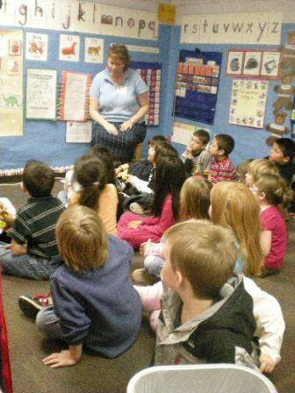
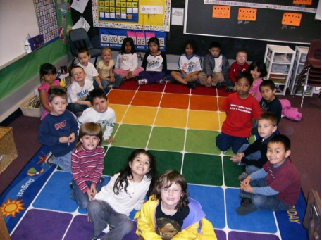
A Typical Kindergarten Day
3
Notes:
Amy/Tammy: Every day after you arrive you will get a chance to greet your teacher and the other boys and girls in your classroom. Usually there are between 20 and 24 children in each class. This is probably more than in preschool. This “rug time” will be an important time to listen and also take turns sharing. Some classrooms start with writing journals, some with morning messages, others with shared reading.

Slide 12
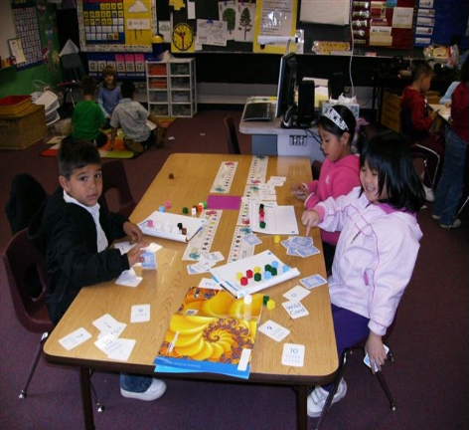
Building on a child’s sense that
“I have successful social skills” and “I can name and control my emotions.”
  Understanding of self
  Working in a group
  Classroom & school community
  Problem solving
Notes:
Amy/Tammy: Every school has rules about how people act at school so everyone can learn and play happily together. You’ll learn more about how to do things in your classroom, in the gym, the music room, the library, the computer lab, and at recess.

Slide 13
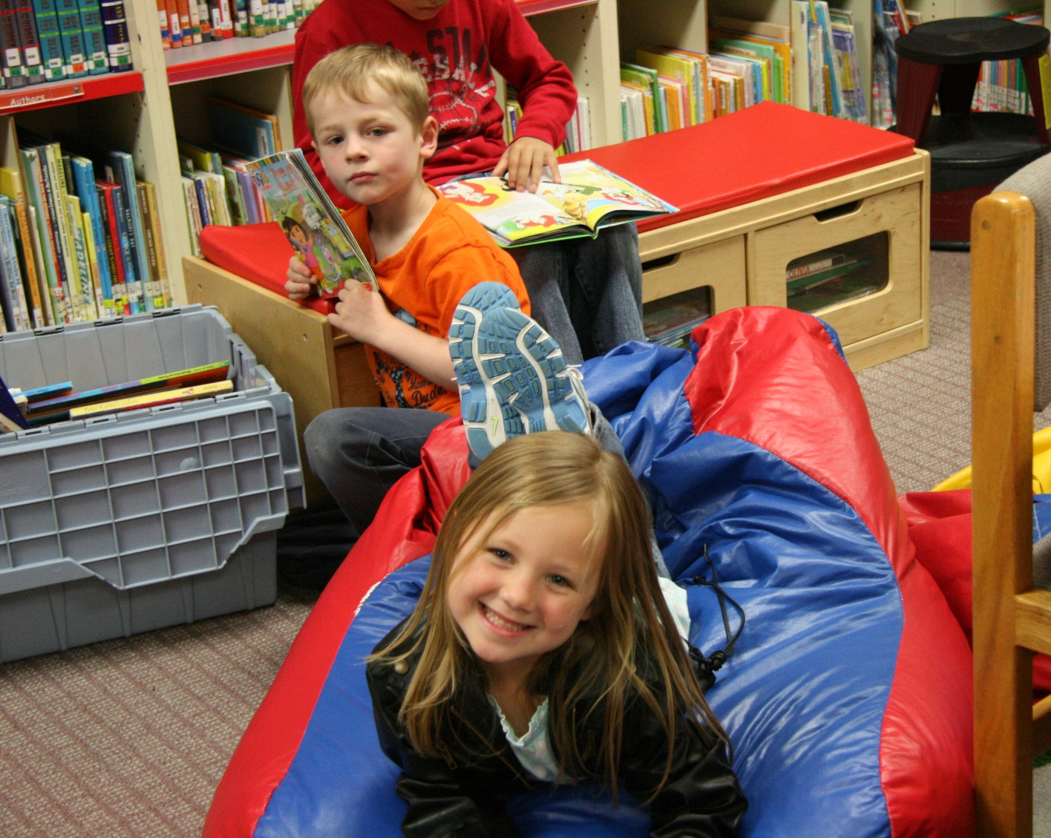
Learning Centers--Plan/Do/Reflect
  Students plan who, what and where
  Share their plan
  Work their plan
  Reflect on their plan
Notes:
Amy/Tammy

Slide 14
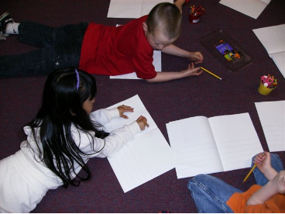
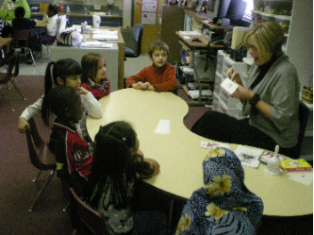
Reading
  Standards focus on:
  Learning how stories work
  Sounds of letters and words
  Being a part of a classroom discussion
Notes:
Amy/Tammy: You’ll be learning about listening and taking turns to share what you know and think. Everyday you’ll hear stories with your class, work on learning letters, sounds and words. You’ll be writing about what you’re doing and learning and about the stories you’ve heard. You’ll get to do all sorts of different activities and games as you are learning to read and write.
Formats of Learning: Large group, Small group, Individual activities, Center activities. If you speak a language other than English, it’s really important for families to talk with their child in your home language. A strong foundation for literacy development begins with a solid knowledge of any language.

Slide 15
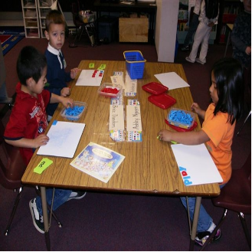
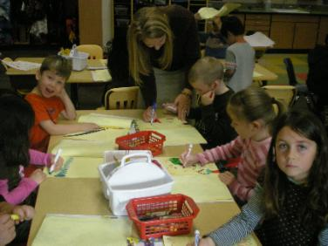
Building on a child’s sense that
“I am a writer”
  Standards focus on
  Describing format
  Narrative format
  Elements of writing
  Revising
  Writing in different modes:
  - Personal stories
  - Labels
  - Lists
  - Science journals
Notes:
Amy/Tammy: You’ll learn letter sounds and how to sound out and write words. You’ll get a chance to write labels on your pictures, to make lists, to draw and write in your journal and to make drawings and write about what you’re learning in science.

Slide 16
What are children doing?
  Reading
    Guided
    Shared
    Partner
    Independent
    Center activities
Writing modes:
- Personal stories
- Labels
- Lists
- Science journals
Notes:
Amy/Tammy: You’ll learn letter sounds and how to sound out and write words. You’ll get a chance to write labels on your pictures, to make lists, to draw and write in your journal and to make drawings and write about what you’re learning in science.

Slide 17
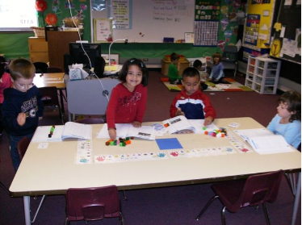
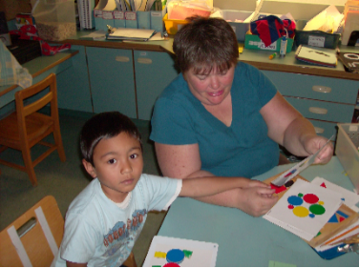
Mathematics
  Standards focus on:
  Number sense
  Counting objects
  Patterns
  Forming groups
  Shapes
  Measurement & graphs
  Problem solving
Notes:
Amy/Tammy: Every day you’ll spend time learning math. You’ll get to use blocks, shapes and counters. All year you’ll learn more about numbers, counting, beginning to add and subtract. You’ll also get to do some measuring, solve problems using numbers and make graphs with your classmates.

Slide 18
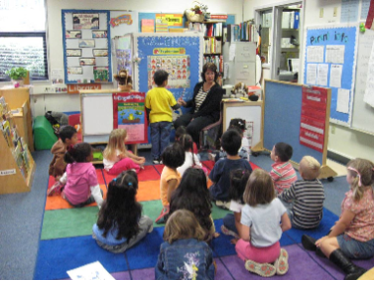
Calendar
  Students identify the day, month and year. They count the days of the school year.
  They chart the weather together.
  They practice patterning, counting, and adding on.
Notes:
Amy/Tammy: Each day you’ll do the calendar with your classmates and record the day and weather.
Parents, the calendar time is an important time for learning lots of math including shapes, patterns, numerals, ideas like more, less, before, after, etc.

Slide 19
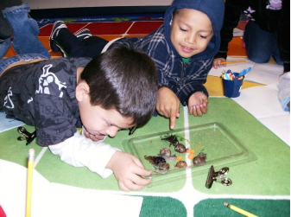
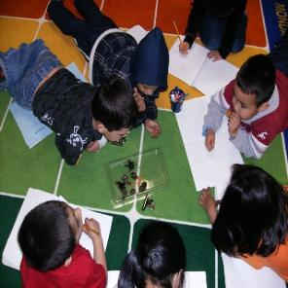
Building on a child’s sense that
“I am a scientist”
  Balls & Ramps
  Animals 2x2
  Living and non-living things
  Asking questions
  Making observations
  Using tools to solve problems
Notes:
Amy/Tammy: Science is another part of the day! You’ll get to learn about animals, about how a ball moves on flat surfaces and on ramps and much more. You’ll get to use tools to solve problems.

Slide 20
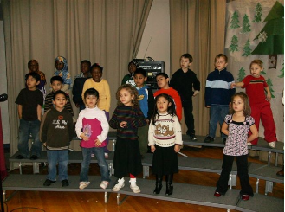
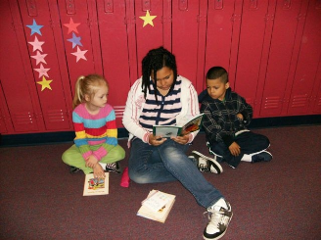
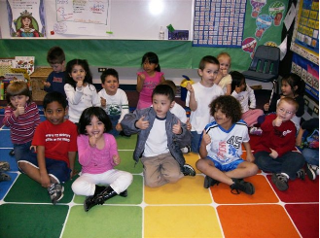
Songs, Stories & Chants
Notes:
Amy/Tammy: After the rug you’ll have stories, sing songs and perform chants together. You’ll also get to sing during music and sometime during the year you’ll get to get up and perform for your family. Sometimes you’ll get to work in small groups with your teacher or other adults who are helping. We also prepare for our annual family concert.

Slide 21
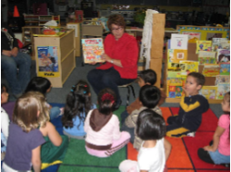
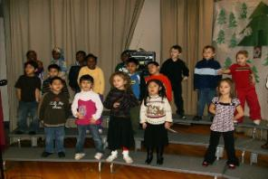
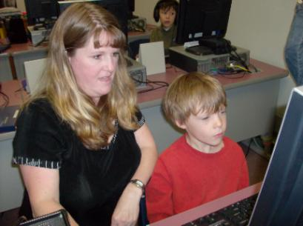
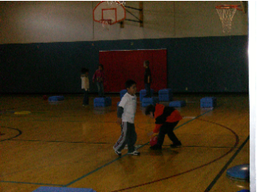
Specialist Programs
Music
Library
Computer/Technology Lab
Physical Education (PE)
Notes:
Amy/Tammy: Kindergarten children go to music in the music room and PE in the gym. They also go to the library to hear books and learn about how to check out books.
Students also take part in art and guidance.

Slide 22

Lunch & Snack
  Buy or bring a lunch
  Parents can set up an account on line
  We want to know about food allergies
  Reduced and free lunches are available if needed
  Snacks are organized by the teacher
3 & 4
Notes:
Amy/Tammy: Going outside for recess is a great time of the day! You get to run, play with friends, and use the playground equipment.
It’s also a time to learn how to play with others and develop friendships. Teachers will help you know where you can play and how to get to and from the playground.

Slide 23
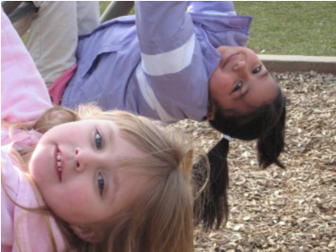
Recess & Outdoor Play
  Making choices during less structured time
  Promoting physical activity
  Learning to play safely with others—taking turns, sharing, problem-solving
Notes:
Amy/Tammy: Going outside for recess is a great time of the day! You get to run, play with friends, and use the playground equipment.
It’s also a time to learn how to play with others and develop friendships. Teachers will help you know where you can play and how to get to and from the playground.

Slide 24
Begin Two-Way Communication
Meet Your Teacher Sept 4th
WaKIDS Conferences Sept 5-7
WatchDOG Kick-off September 20th
Curriculum Night September 27th
Parent/Teacher Conferences
Teacher newsletters and emails
Do not just drop in—there are 48 of you
Notes:
Amy/Tammy

Slide 25
Parent Involvement!
It is a triangle: student, parent, teacher
Daily folder
PTA, Room Parent, WatchDOG, Library, Chaperone, Art Docent, Junior Achievement,
4
Notes:
Amy/Tammy

Slide 26
Volunteering
Complete Application for approval
Teachers need assistance
  Materials preparation
  One-on-one (confidentiality)
Sign in and out in office
4 & 5
Notes:
Amy/Tammy

Slide 27

Independent skills we target:
  Zip coat
  Put on a tee shirt
  Deal with backpack
  Tie shoes
  Blow nose
  Use bathroom
  Wash hands
Notes:
Amy/Tammy: Kindergarten is also about learning how to get along with others and how to manage yourself when there are more children around. The counselor will come into the classroom and work with the whole class. You’ll learn about sharing how you’re feeling, how to use your words if you’re not happy about something, and how to solve problems with friends. You’ll also learn about how to keep yourself safe when you’re at school.

Slide 28
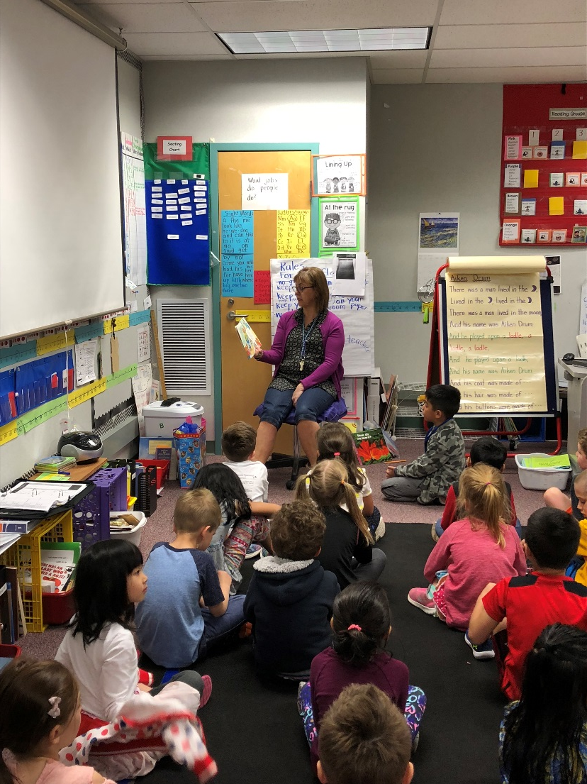
Social and school readiness skills we target:
  Following routines
  Sharing and helping others
  Becoming a self-manager
  Recognizing feelings in self and others
Our Counselor and Guidance
Notes:
Amy/Tammy: Kindergarten is also about learning how to get along with others and how to manage yourself when there are more children around. The counselor will come into the classroom and work with the whole class. You’ll learn about sharing how you’re feeling, how to use your words if you’re not happy about something, and how to solve problems with friends. You’ll also learn about how to keep yourself safe when you’re at school.

Slide 29
Home/School Communication
If you have a question, contact your child’s teacher. Teachers are available from 8:25 - 9:05 in the morning and also after school until 3:55.
You may email a teacher—teachers check their messages at least once a day
    Firstinitiallastname@everettsd.org
Notes:
Daniel:

Slide 30
Arrival – Departure Times
Students should not arrive before 9:00 a.m. There is no supervision available.
School begins at 9:10. The tardy bell rings at 9:15 a.m.
Students are dismissed at 3:30.
Notes:
Daniel

Slide 31
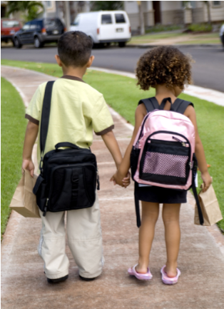
  How do children get to Cedar Wood?
    Walk with older student
    Parents drive, carpool
    Bus from some neighborhoods
Notes:
David: Children get to school in different ways. If you live close to school (one mile or less) and don’t have to cross any major roads, children may walk with an adult. Otherwise parents bring them, or they ride a bus. Our transportation department will have information on bus routes and stops right before school starts. Their telephone number (425-385-4144) is in the Parent Booklet that you’ll be getting today. You can also get this information on the school district website (www.everett.k12.wa.us). That’s also listed at the beginning of the booklet.
Parents can also choose to drive their child to school. At Cedar Wood we have a Kiss ‘n Go lane out front, but kindergarten children must be walked by hand to the kinder line up area before school.

Slide 32
Getting to and from school
Start your transportation routine on the first day. Routine, routine, routine.
At “Meet Your Teacher” the afternoon before the first day of school you will be given a name badge for your child. Attach the tag to your child’s backpack.
Notes:
David

Slide 33
If you drive your child to school
Do not arrive until 9:00 a.m.
Park. Hold your child’s hand, use the crosswalk and walk together to the kindergarten gate.
Say goodbye at the gate. Do not enter the playground. Your student will join his/her class in line and will be supervised by staff.
Reverse these steps in the afternoon.
Notes:
David

Slide 34
If your child will ride a bus
Practice going to the bus stop prior to the first day. Locate landmarks so that your child will recognize where to get off on the way home.
An adult must meet your kindergartner. (If your kindergartner has an older sibling on the same bus you can make arrangements with the driver.)
Notes:
Daniel

Slide 35
Changes in Regular Dismissal
Change of routine? Changes could include:
  Being picked up instead of riding the bus
  Going home with another child
  Riding a different bus
  Being picked up by another adult on your approved list
Send a note/email to the teacher. If there is no note, your child will be sent home as usual.
Notes:
Daniel

Slide 36
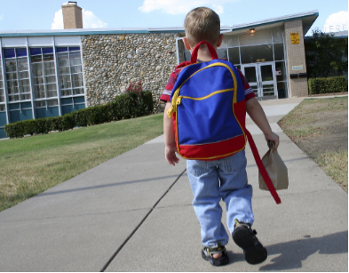
Plan Family Events Now So Your Child Attends Every Day
  Every day is packed with critical learning which can not be made up.
Notes:
Daniel: Attendance – regular, daily and on-time

Slide 37
Who will be my child’s teacher?
Teacher assignment will be made in late August.
WaKids family conferences take place the first three days of school. Students do not attend school on these days. Select your time on line.
School probably starts for kindergartners on Monday, September 10th
Notes:
David:

Slide 38
Kindergarten Academy for Parents
Learn from Kindergarten teachers how we teach reading, math and social skills
Next Thursday, May 17th, 6:00 – 7:00
Meet in Library, spend time in classrooms
Notes:
David

Slide 39

Notes:
David

Slide 40
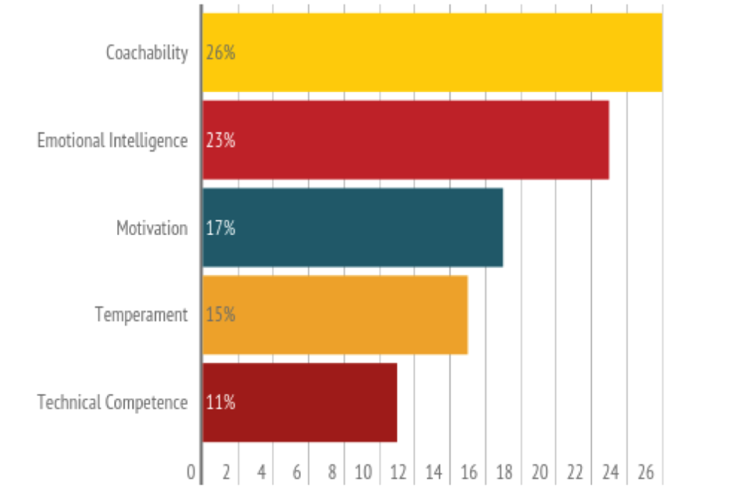
46% of new hires fail and are let go
(survey of 5,247 hiring managers)
Notes:
David

Slide 41
If you are a book person:
Brain Rules
Grit: The Power of Passion and Perseverance
Mind in the Making
Mindset
Willpower
(many are on YouTube and TedTalk)
Notes:
David

Slide 42
Next Steps:
Attend Kindergarten Academy next Thursday at 6:00
Come to Family Carnival May 24th 6:00 – 8:30
Spend time on the playground on the weekend
Come to the Sea-Pup summer events and Kinder picnic
Wait for call in August to schedule your WaKids Family Connection appointment
Come to Meet Your Teacher September 4th at 4:00.
Notes:
David:

Slide 43
http://www.everett.k12.wa.us/cedarwood/
Questions?
Notes:
David, Amy, Tammy, Daniel, Rhoda

